Slide 1

How AI is driving change across information security and finance.
Robin Grosset, CTO
www.mindbridge.ai

Slide 2
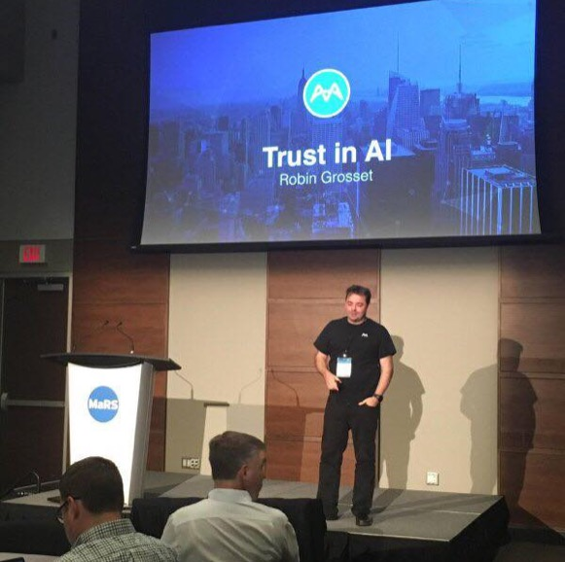
About me
Robin Grosset
Erstwhile Physicist from Scotland
20+ years in Business Analytics
16+ patents in the area of data processing, analytics and security
Founder, acquired twice: Cognos and IBM
Appointed IBM Distinguished Engineer
Watson Group in IBM, Chief Architect of Watson Analytics
“InfoWorld's 2016 Technology of the Year” winner
Now CTO of MindBridge working on revolutionizing financial anomaly detection with Artificial Intelligence

Slide 3
Big Data

Slide 4
68% of CEOs believe data and analytics will generate the greatest return on stakeholder value
“The major trend that all industries face is the impact of technology on every single aspect of a company. Whether it’s enhanced intelligence, from big data analysis to help managing marketing, risk, product creation, or assessment of ideas … technology is going to lead to sea changes in how companies are organized and run across all industries”
Brian Moynihan Chief Executive Officer, Bank of America Corporation, US
Technology and the need for Analytics will drives change..
Source (PwC 19th Annual Global CEO Survey Published January 2016)
Photo © World Economic Forum, Photo by Michael Wuertenberg

Slide 5
This is the end of ‘tech companies’ … only ‘companies’, steeped in technology will survive
Naval Ravikant commented, “Competing without software is like competing without electricity.” The rise of the Data era, coupled with software and connected device sprawl, creates an opportunity for some companies to outperform others. Those who figure out how to apply this advantage will drive unprecedented wealth creation and comprise the new S&P 500.
5 largest companies today are considered ‘tech companies’
(Apple, Alphabet, Microsoft, Facebook, Amazon)
NewCo. Rob Thomas: https://shift.newco.co/the-end-of-tech-companies-b093e82d1118#.a1x3955x2
Image attribution: Kris Krüg

Slide 6

Big Data Tsunami
Every day we create 2.5 quintillion bytes of data (10^18)
90% of the worlds data was created in the last 2 years
The current trend indicates data is doubling every 18 months
Leveraging this data is a big problem
data
People who can surf this wave are known as
data scientists…
time

Slide 7
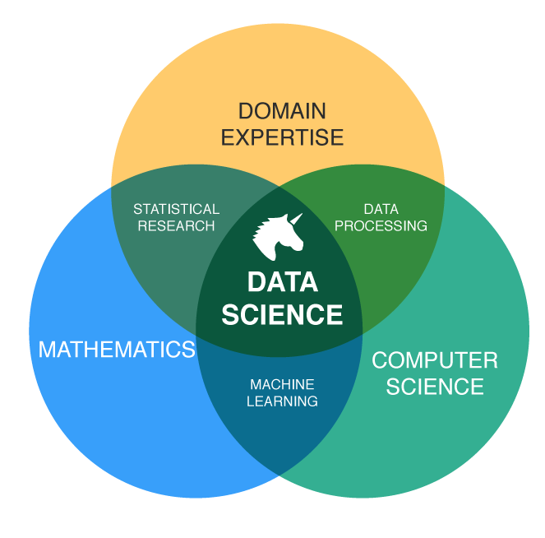
Data Science is in demand
3x as many job openings as people to fill them…
83% say they are struggling to find Data Scientists
human capital is in short supply...
https://www.datanami.com/2016/03/25/tracking-data-science-talent-gap/
Notes:
https://www.datanami.com/2016/03/25/tracking-data-science-talent-gap/

Slide 8



Big Data
coping mechanisms
Data Science: gathering, exploring, and modeling data
Machine Learning: techniques in computing science where a machine can learn from exposure to data in a supervised or unsupervised way
Artificial Intelligence: a field of computer science. Its goal is to enable the development of computers that are able to do things normally done by people -- in particular, things associated with people acting intelligently.
Notes:
https://www.datanami.com/2016/03/25/tracking-data-science-talent-gap/

Slide 9
AI – Why now?

Slide 10

The new AI spring

Slide 11


2014: DeepMind Q Learner
Reward (Score)
Raw Pixels
Game State
Game
Controls
Demis Hassabis
DeepMind Co-Founder

Slide 12
Artificial Intelligence is the new Electricity
“Just as electricity transformed almost everything 100 years ago, today I actually have a hard time thinking of an industry that I don’t think AI will transform in the next several years”
Andrew Ng,
Chief Scientist of Baidu; Chairman and Co-Founder of Coursera; Stanford CS faculty
https://www.gsb.stanford.edu/insights/andrew-ng-why-ai-new-electricity

Slide 13
How AI & Machine Learning are changing many professions
Insurance: Intelligent Claims Processing
Process mining to identify bottlenecks and improve efficiency. Identify patterns of fraud. Build predictive underwriting models
Legal: Paralegal Powered by AI
ROSS is an A.I. lawyer that helps human lawyers research faster and focus more on advising clients
Healthcare: Watson Oncology
Evidence based treatment options learned from world renowned MSK experts. “like having a capable, knowledgeable colleague” working with every clinician

Slide 14

A New Hope a new generation of AI
DeepMind acquired by Google for £400M
Google Cat Detector finds cats in videos completely unsupervised.
Uses Deep Reinforcement Learning
Why is this important?
More accurate than any previous method
Enabled by large scale Cloud compute
We can now train AIs quickly and in a general way to solve problems across different domains

Slide 15
Applying AI in the real world
The MindBridge Story

Slide 16
A Big Data Problem
Financial loss due to human error or by intent is surging
~$200B
Knowns
~$3T
Unknowns
Estimate losses/yr

Slide 17
Current Tools and Methodologies to Detect Anomalies are Failing
32
40%
Fraud caught by mistakes & tips
MONTHS TO DETECT
3%
80%
Fraud caught by analytics
Surge in fraud incidents
the last 10 years
Source: Association of Certified Fraud Examiners, International Institute of Auditors

Slide 18
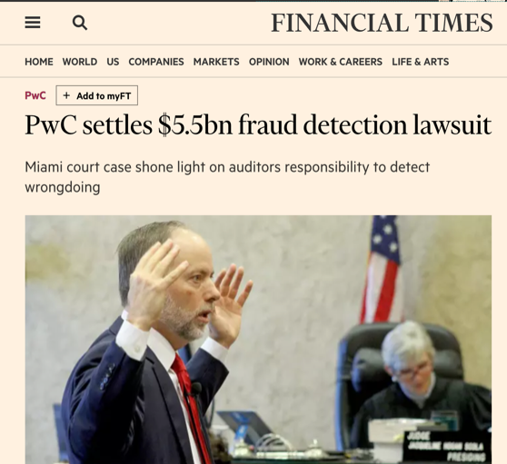
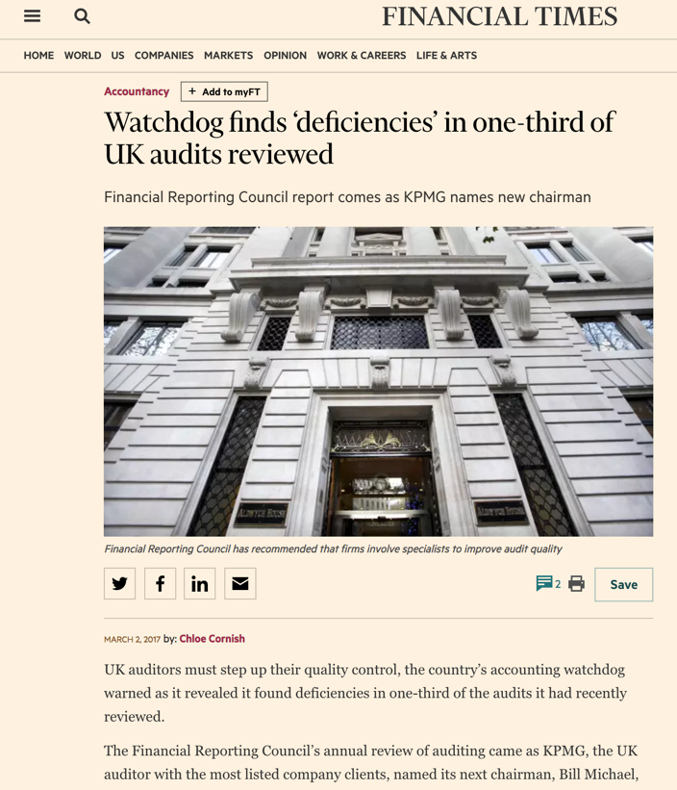
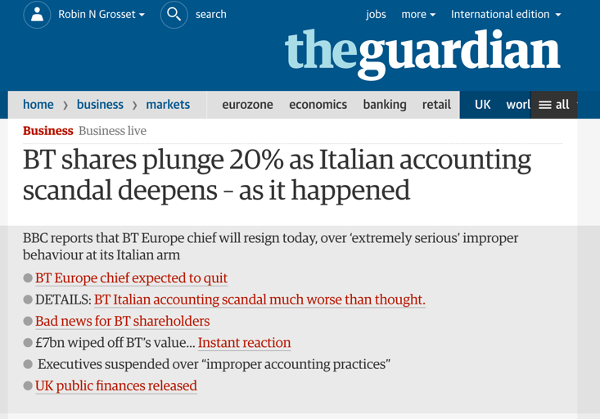
x

Slide 19
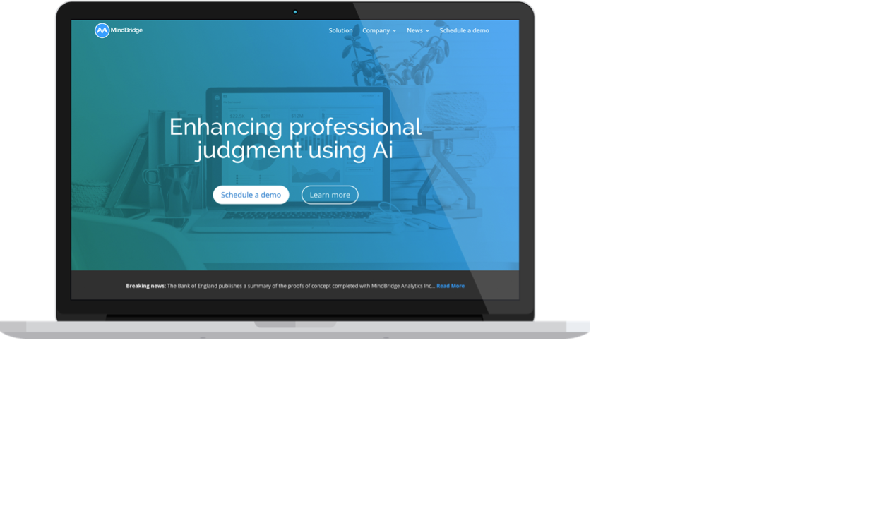
A Partnership
Between Humans & AI
Notes:
Through pilot partnerships with Global and National audit firms, as well as industry expertise, we have developed a platform with business requirements of the industry in mind. We’ve had some very enthusiastic partners in the financial audit space so that’s where we’ve made the most progress. Later on I’ll be demonstrating on our platform because that’s what we have access to show. I can speak for how data science and AI are used in our platform and the key differences between that and common scripting techniques which we often call the “traditional approach”.

Slide 20

MindBridge Identifies Financial Anomalies using a Best-in-class Hybrid of Rules, Methods, Data & ML
Domain expertise
business rules
Statistical methods
Machine
Learning
Cross
correlation
Integrity tests, fraud framework, standard fraud analytics
Benford’s law, 2-3 digit test
Outlier detection, SOS, rarity, reinforced learning
Sanction Lists, Credit Databases, proprietary negative database
Mindbridge Ai

Slide 21
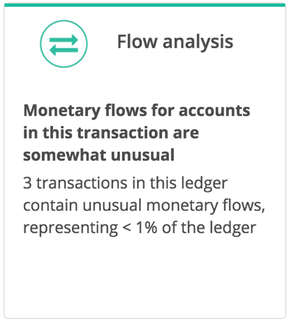
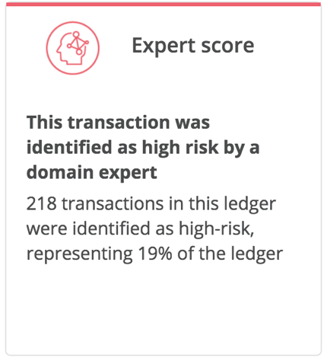
Results…

Slide 22
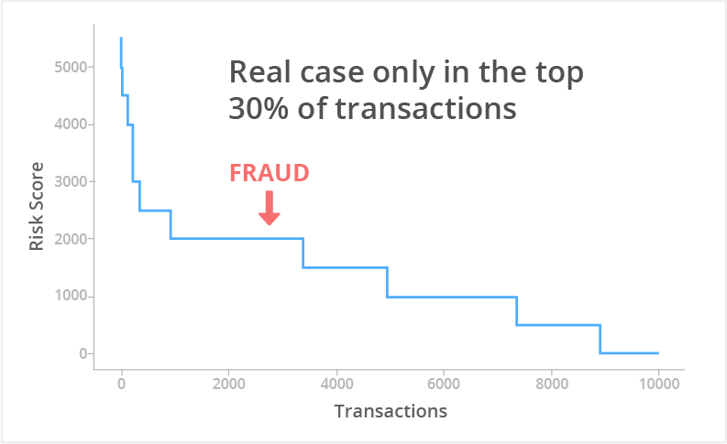
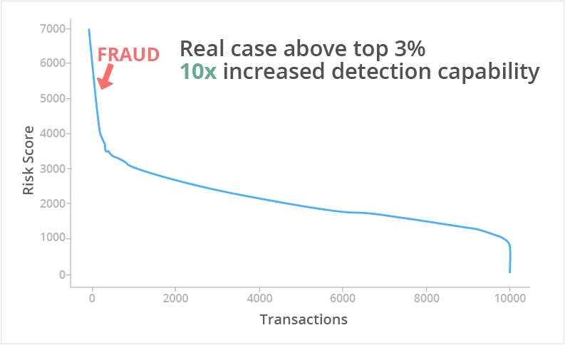
MindBridge Story: How much better is Machine Learning than Rules?
Results…
Rules Alone: Ranked Risk Score
Machine Learning: Ranked Risk Score
“4 of 5 data points your system found were confirmed cases of fraud. Very impressive. Great job.” MindBridge Client

Slide 23
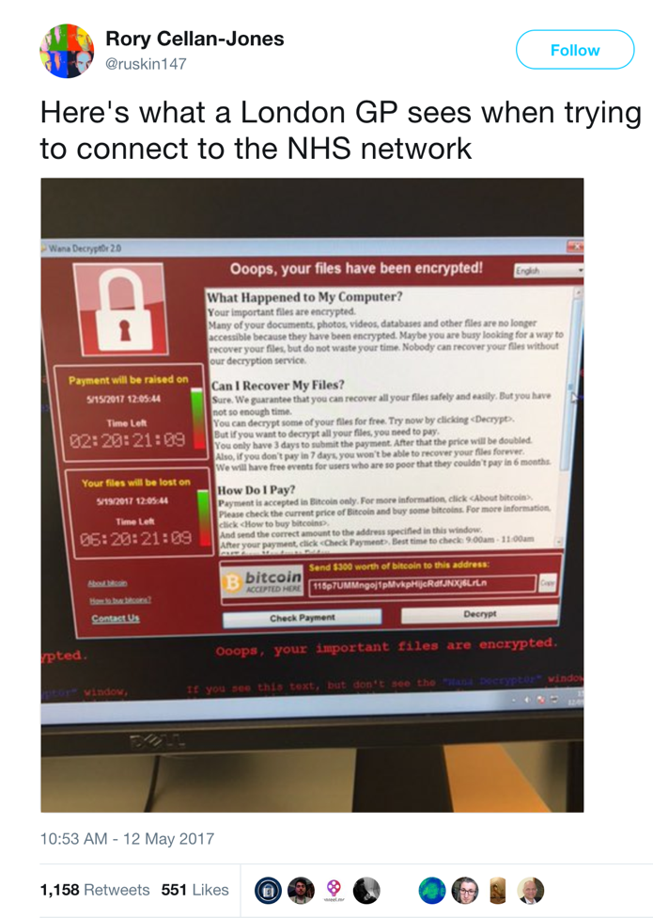
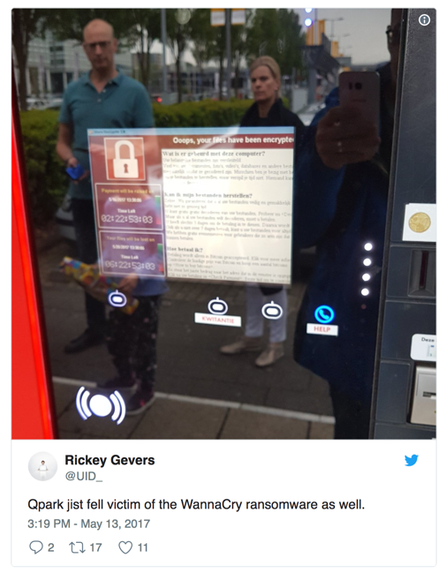
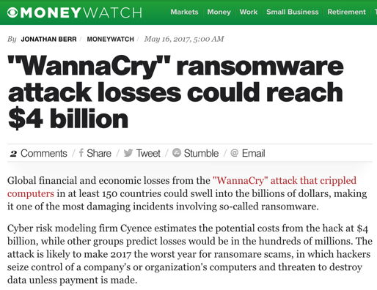
The cost of WannaCry

Slide 24
WannaCry: Only 3 End Point Security Systems Stopped it on day zero.
Symantec Endpoint Protection and Norton
Symantec: “In fact, the Advanced Machine Learning feature alone in SEP proactively blocked all WannaCry infections on day zero, without any updates.”

Slide 25
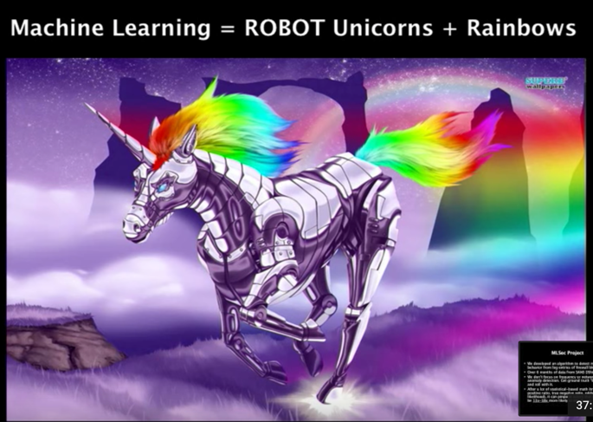
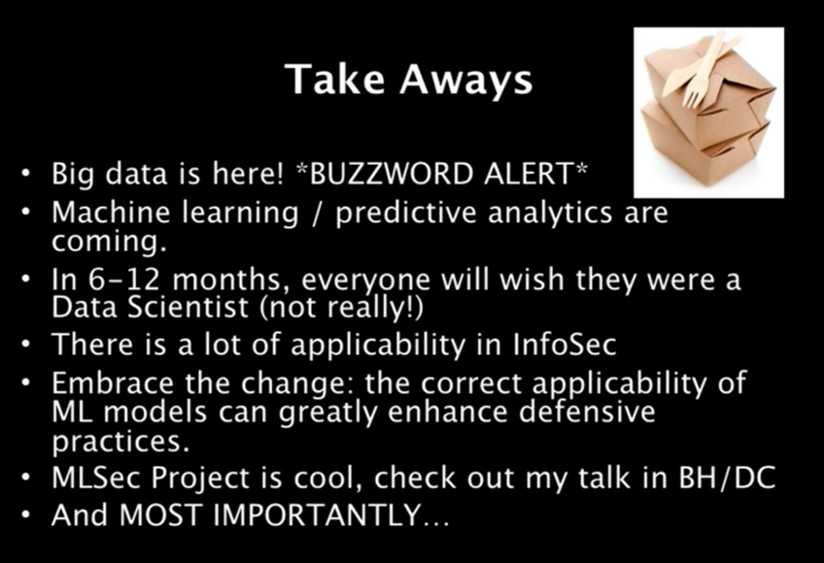

Machine Learning
Security Community
https://github.com/wtsxDev/Machine-Learning-for-Cyber-Security

Slide 26
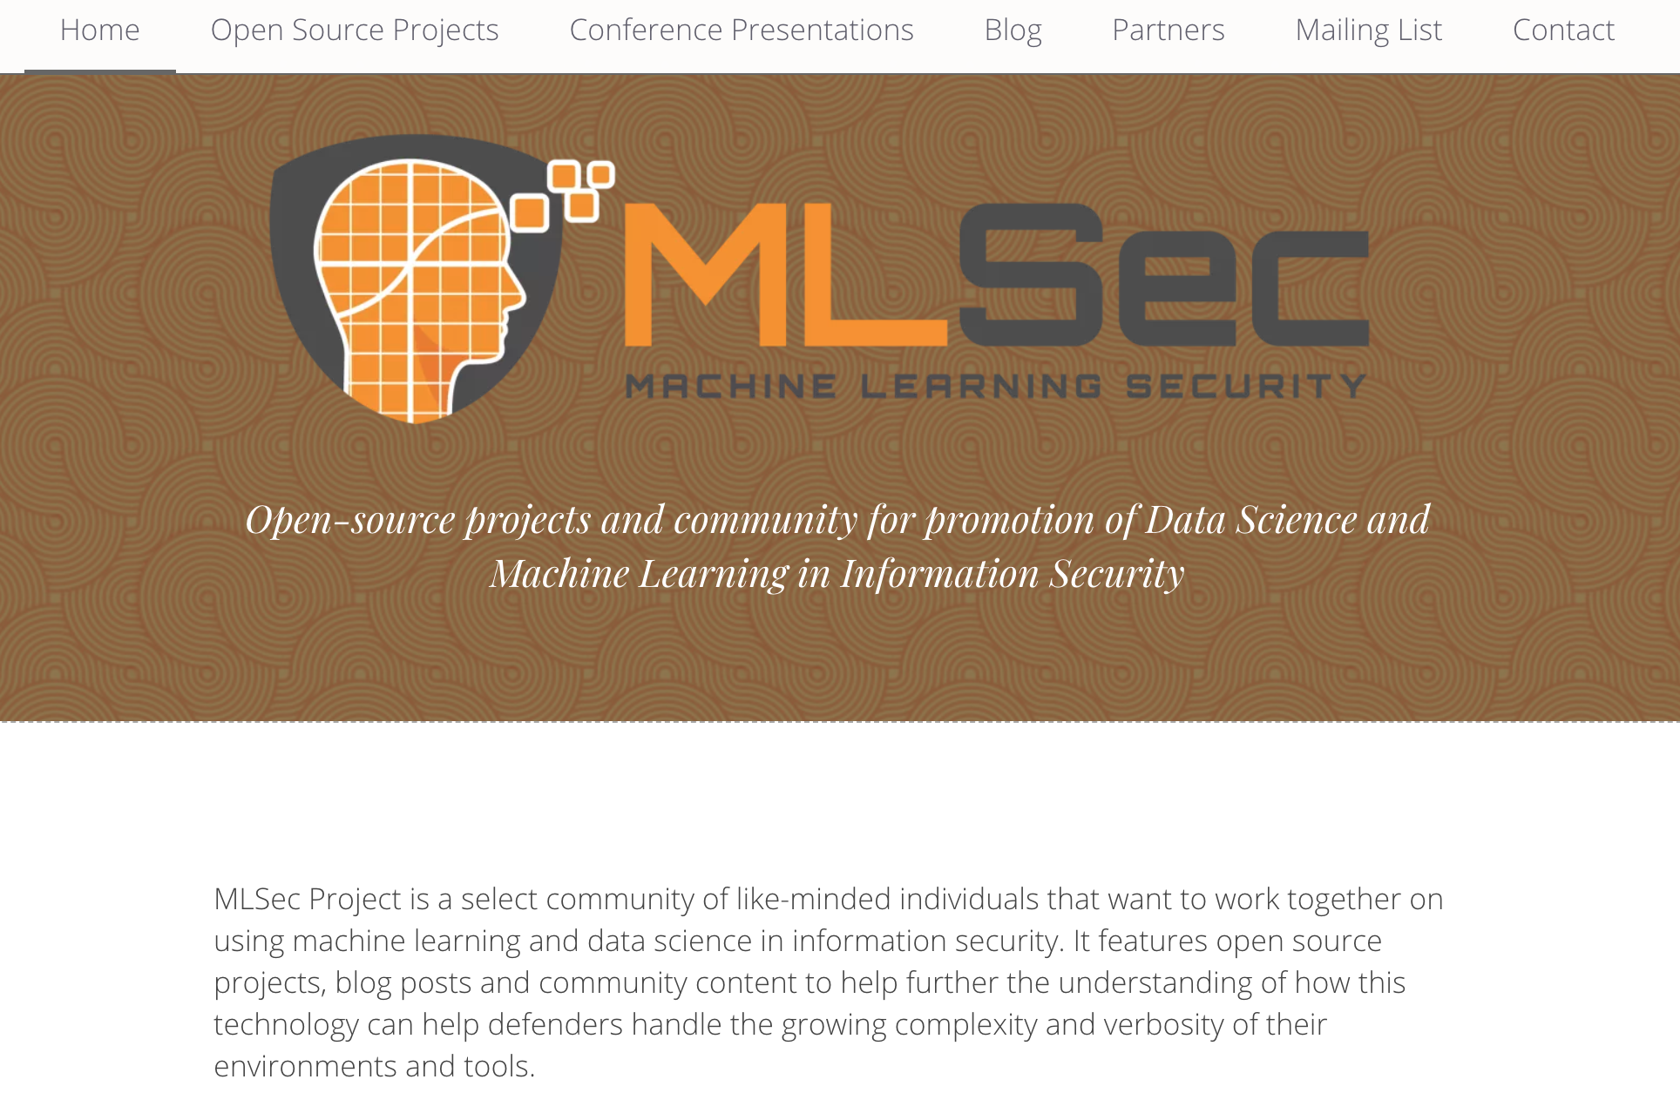
Check it out

Slide 27
Takeaways

Slide 28

Key Takeaways
Data is changing the world around us
Analytics and Machine Learning is fueling a competitive future in all areas including the security space.
Its no longer enough to to just analyse data we need to apply human like intelligence at vast scales
AI is in all of our futures

Slide 29



Don’t Forget
To follow us on
MindBridge AI
@mindbridge_ai

Slide 30
Thank You!
Robin Grosset
robin@mindbridge.ai

